Slide 1
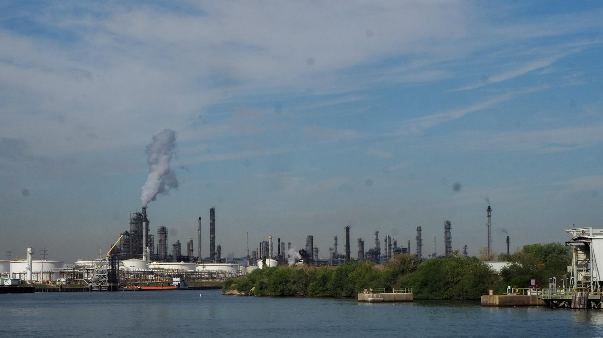


Galena Park - Air Quality Data Insights
05/01/2025

Slide 2
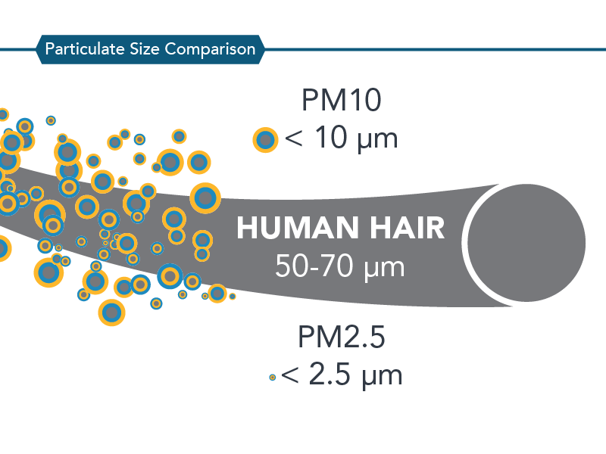
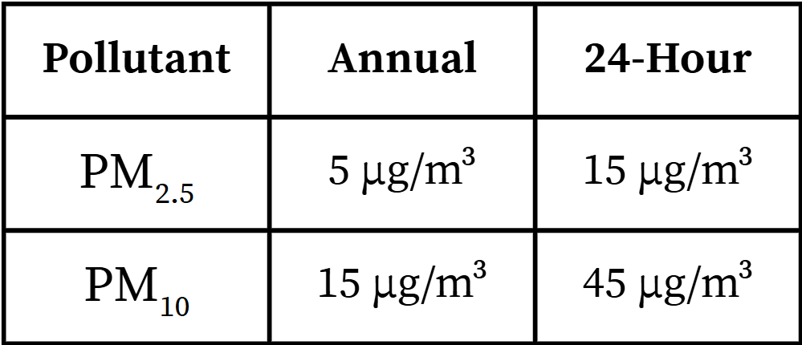
What are Particulate Matter (PM) ?
PM - Particulate Matter
Mixture of tiny solids or liquid droplets in the air
1,2.5,10 - Refers to the size (in micrograms) of the particles
WHO guideline:
Source: California Air Resources Board

Slide 3
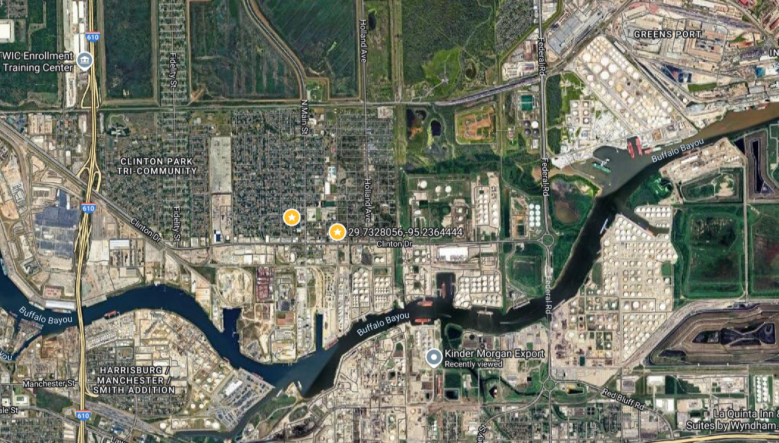
Where are ECAGP’s sensors located ?
Eastway St
Clinton Dr

Slide 4
Where are ECAGP’s sensors located ?
Eastway St
Clinton Dr
Which one do you think is going to show higher pollution?

Slide 5
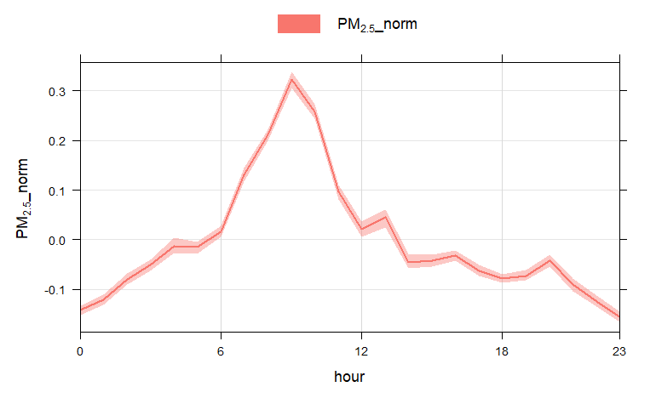
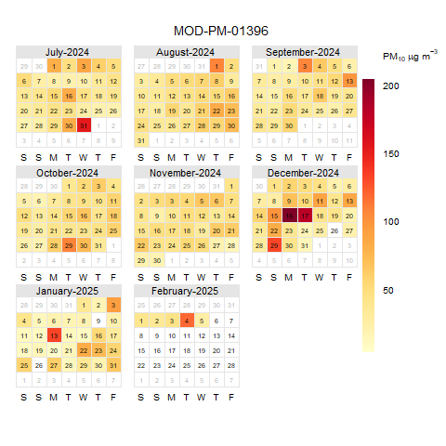
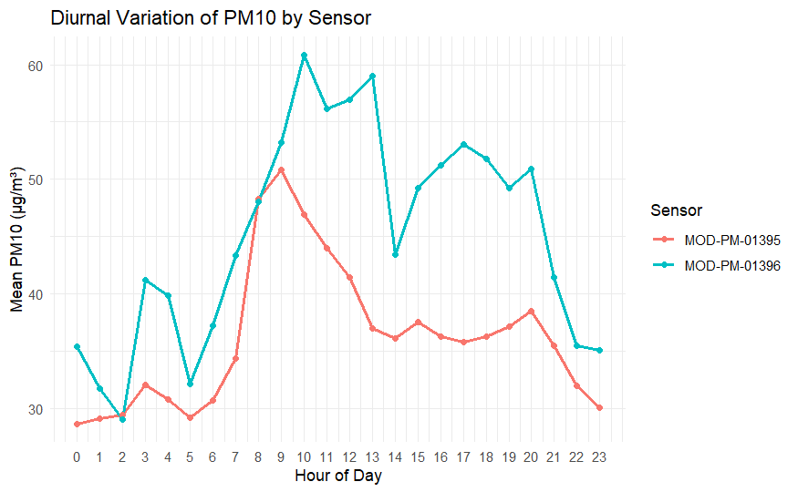
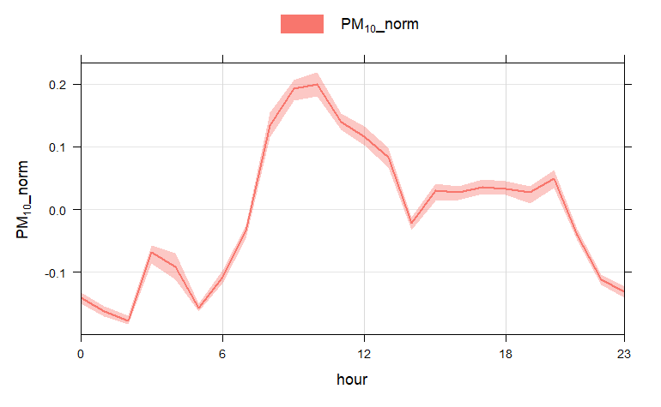
What does the data tell us?
Elevated PM₁₀ Levels in Galena Park Area
Extreme PM₁₀ Event – December 2024
PM₁ and PM_{2.5} Originate from Different Sources Than PM₁₀
Eastway St
Clinton Dr
Notes:
Here are the 3 major insights that we found from the data
Some of the information confirms what the residents of Galena Park have already been feeling

Slide 6
What does the data tell us?
PM₁₀ levels in Galena Park are higher than recommended levels
There was an extreme PM₁₀ event in December 2024
PM₁ and PM_{2.5} originate from different sources than PM₁₀
Notes:
Here are the 3 major insights that we found from the data
Some of the information confirms what the residents of Galena Park have already been feeling

Slide 7
What does the data tell us?
PM₁₀ levels in Galena Park are higher than recommended levels
There was an extreme PM₁₀ event in December 2024
PM₁ and PM_{2.5} originate from different Sources than PM₁₀
Notes:
Here are the 3 major insights that we found from the data
Some of the information confirms what the residents of Galena Park have already been feeling

Slide 8
Elevated PM₁₀ Levels in Galena Park Area

Slide 9
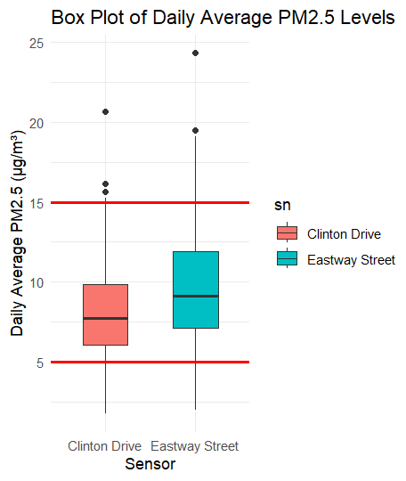
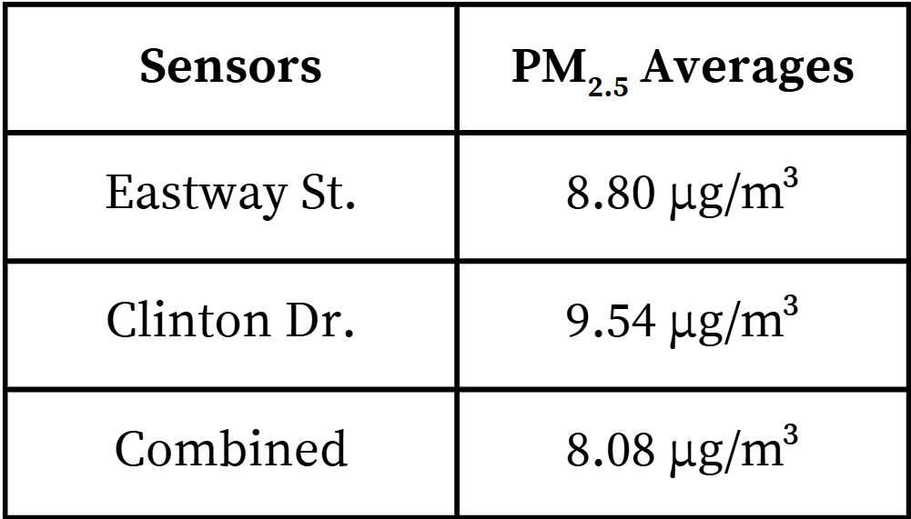
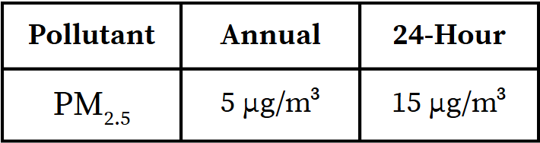
PM_{2.5} Averages Exceeds Annual Guidelines
(7 Months of Data)
WHO guideline:
Notes:
Data:
Here is some data showing the levels of PM 2.5 from sensors through a box plot. The daily average is computed by taking the average of all data from one sensor on one day. The two red lines represent the WHO Standards for 24hr and Annual. Annual standards are lower because they measure long-term exposure and account for short spikes. Breathing in small amounts of pollution every day can cause serious health problems over time.
Analysis:
Even though it's only 7 months of data, it will exceed the annual standard if it continues without change. While there are some data points that are outliers (shown from the black dots above the squares), the daily average is still below the 24hr WHO standard

Slide 10
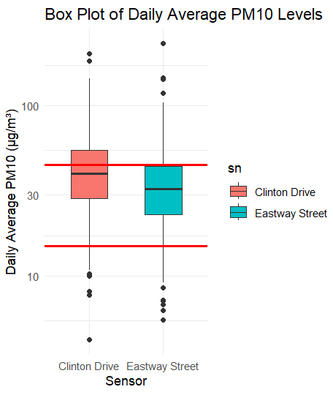
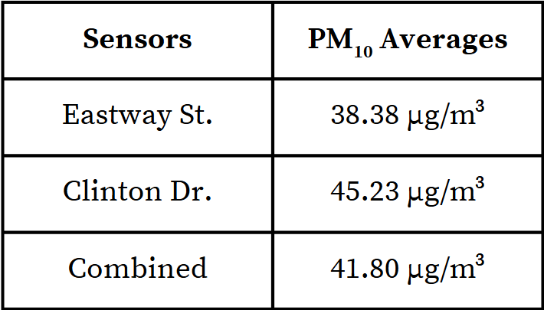
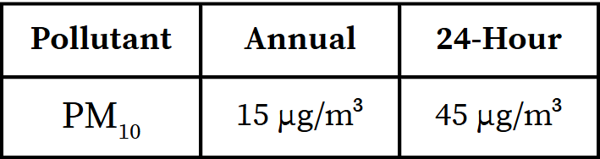
PM₁₀ Averages Exceeds Both Daily and Annual Guidelines
(7 Months of Data)
WHO guideline:
Notes:
Data:
This data is very similar to previous slide but shows PM10. One thing to note that is different from the other is the use of a logarithmic scale since some of the outlier data points are very high and would make the box plot too small to see. A logarithmic scale is a way to show numbers that grow or shrink quickly. Instead of going up by the same amount each step (like 1, 2, 3), it goes up by multiplying (like 1, 10, 100, 1000).
Analysis:
With the other dataset, the sensors were relatively close to the WHO annual standard, but for this Box Plot, it is well above the annual standard and one of the sensors even reaching above the 24 hr guidelines. One concerning thing to point out are the data points above the box plots (which each represent a day) where the average PM10 level was considerably above 100 µg/m³. This data is not only significantly above the annual guidelines, Clinton Drive has an daily average above the 24hr guideline.

Slide 11
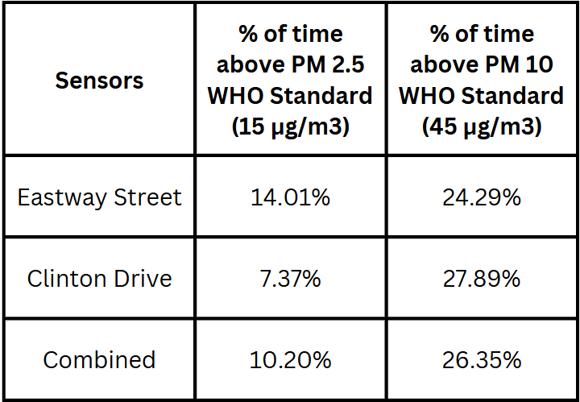
Galena Park spends significant time above WHO standards
The table shows the % of time the sensors detected PM_{2.5/10} levels above WHO Standards
Galena Park is exposed to unhealthy air around a quarter of the time
Notes:
How the table was created:
Take all the data from each sensor separately
Test each datapoint to see if they are above 15 µg/m³ for PM 2.5 and 45 µg/m³ for PM10 and record them
Take the number of points above over the total amount to find % of time
Analysis: For every time the sensor detects PM2.5 above WHO standards, it detects PM10 above WHO standards 2.6 times. The statistics are also staggering since over a quarter of the time, Galena Park experiences air that is above the WHO standards for PM10

Slide 12
When is PM₁₀ pollution worst?
At 1 PM (13th hour), the Clinton Drive sensor records an average of 58 µg/m³
Eastway St
Clinton Dr
Notes:
The graph shows a diurnal of both of the sensors
This shows the level of PM₁₀ on average during a specific time of day
Clinton Drive levels of PM₁₀ are overall higher compared to Eastway Street showing that PM₁₀ is more prevalent towards Clinton Drive (southeast)

Slide 13
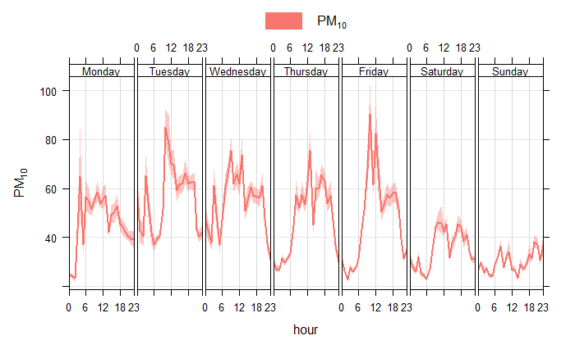
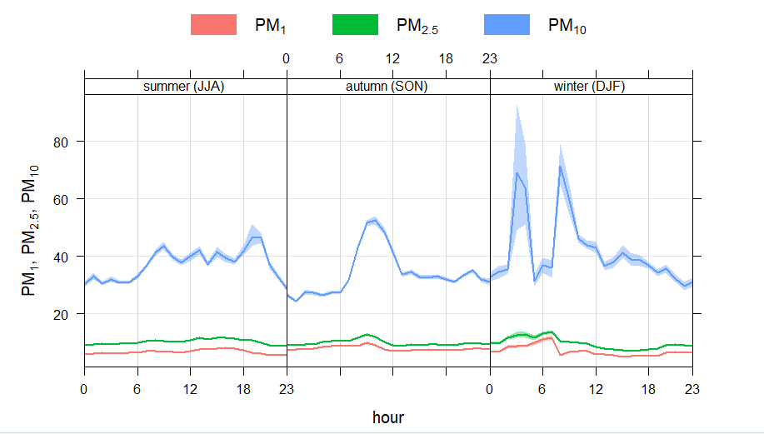
When is PM10 the worst?
PM₁₀ is worst during the weekdays and morning hours
The darker lines represent the average and the lighter shading shows the variation
One thing to note is high variation within the winter season which was mainly caused by a specific PM₁₀ event

Slide 14
PM₁₀ Events in December 2024

Slide 15
What does the data tell us?
PM₁₀ levels in Galena Park are higher than recommended levels
There was an extreme PM₁₀ event in December 2024
PM₁ and PM_{2.5} originate from different sources than PM₁₀
Notes:
Here are the 3 major insights that we found from the data
Some of the information confirms what the residents of Galena Park have already been feeling

Slide 16
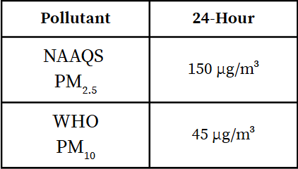
When was PM₁₀ the worst?
Air Quality Guidelines:
There are two days within 7 months that have exceeded that 24 hour limit

Slide 17
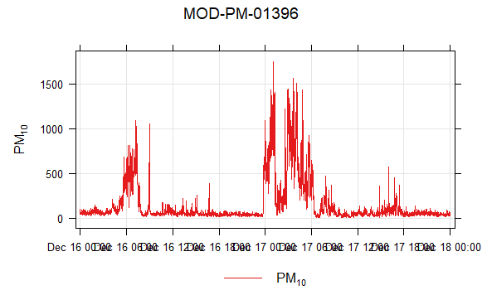
What happened that day?
There was a sustained source of PM₁₀ that lasted 10 hours

Slide 18
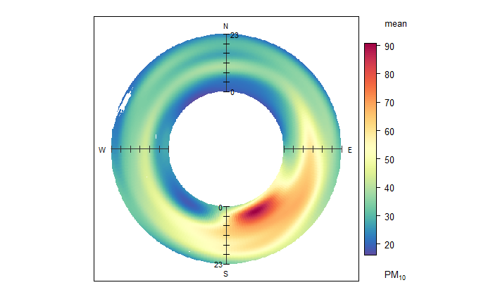
Reading Polar Annulus Map
Shows the direction of the source relative to the sensor
How close to the inside of the circle determines when the pollution happened
On average, it is 90 µg/m³ earlier in the day and the source is coming from the South Southeast
Notes:
Analysis: To

Slide 19
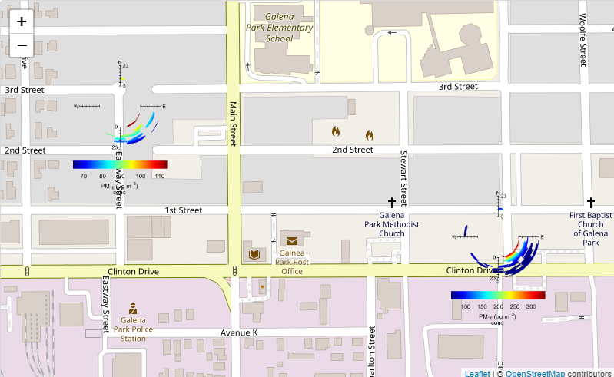
Where did it come from?
Usually it's a fully formed circle (like the top right) but this shows data from only 12/16-12/18
Both sensors detected that the pollution came from the Southeast
Notes:
Analysis: Based on the annulus map, it shows that the pollution only during that period happened towards the southeast region. Also the most intense areas of pollutions happened very early in the morning in that direction.

Slide 20
PM1 and PM2.5 Come from Different Sources Compared to PM10

Slide 21
What does the data tell us?
PM₁₀ levels in Galena Park are higher than recommended levels
There was an extreme PM₁₀ event in December 2024
PM₁ and PM_{2.5} originate from different sources than PM₁₀
Notes:
Here are the 3 major insights that we found from the data
Some of the information confirms what the residents of Galena Park have already been feeling

Slide 22
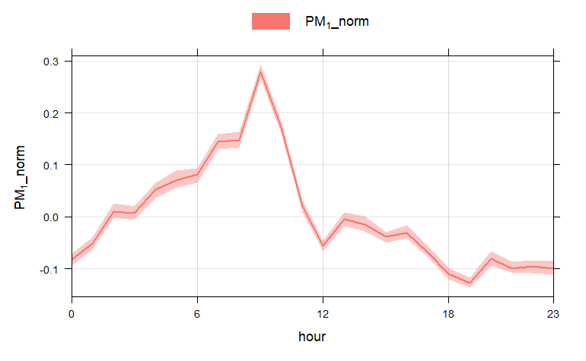
A typical day for PM1 and PM2.5
These graphs are normalized (instead of actual numbers, they show a scale from 0, the lowest value, and 1, the highest value)
They are normalized to show the peaks and valleys and their movements throughout the day
PM1 and PM2.5 have a very similar shape compared to PM10 (which is on the next slide)

Slide 23
A typical day for PM10
PM10 has a sharper spike in the morning
There is also a small spike that is not found in the other graphs at 3 am
The magnitude also persist throughout the rest of the day

Slide 24
What does a typical day look like for each PM size?
PM₁
PM₁ and PM_{2.5} have a very similar shape, unlike PM₁₀
PM_{2.5}
PM₁₀

Slide 25
What does a typical day look like for each PM size?
PM₁
PM₁ and PM_{2.5} have a very similar shape, unlike PM₁₀
PM_{2.5}
PM₁₀
Spot the differences!

Slide 26
What does a typical day look like for each PM size?
PM₁
PM₁ and PM_{2.5} have a very similar shape, unlike PM₁₀
PM_{2.5}
PM₁₀
Spot the differences!

Slide 27
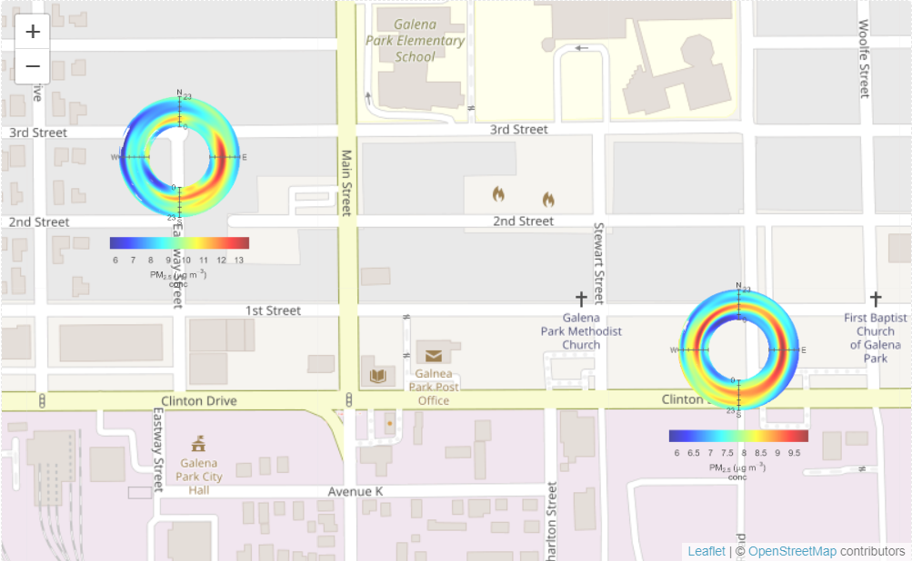
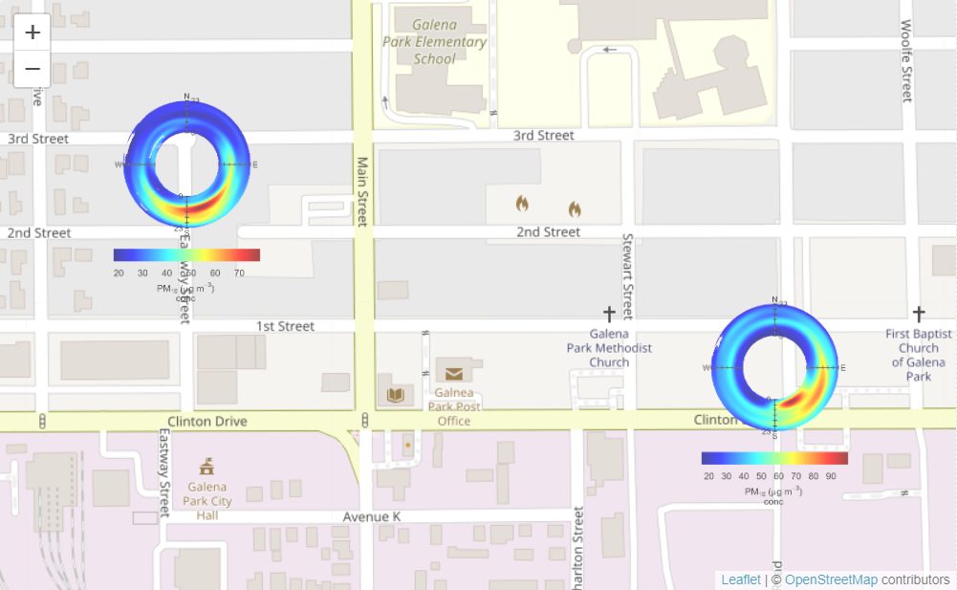
PM₁& PM_{2.5} are coming from different directions than PM₁₀
PM_{2.5}
PM₁₀
Local emissions, like traffic, but also regional
Clear southeast signature

Slide 28
Thank you!
francesca@airpartners.org

